Slide 1
Mushroom Edibility Classification
Anieesh Saravanan and Pranav Akiri

Slide 2
— Croatian Proverb
“All mushrooms are edible; but some only once.”

Slide 3
Table of contents
01
02
03
04
Project Overview
Preprocessing
Relevance and Dataset Characteristics
Preparing the Dataset for Manipulation
Manipulation
Conclusion
Eliminating attributes and classification
Results and Future Work

Slide 4
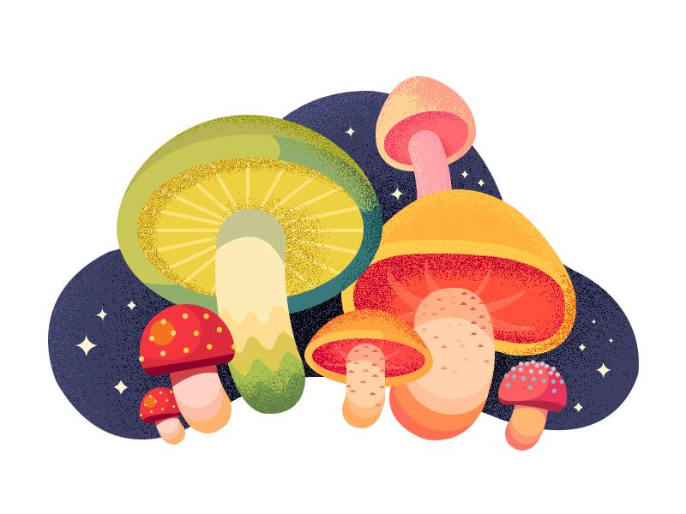
00
Introduction

Slide 5
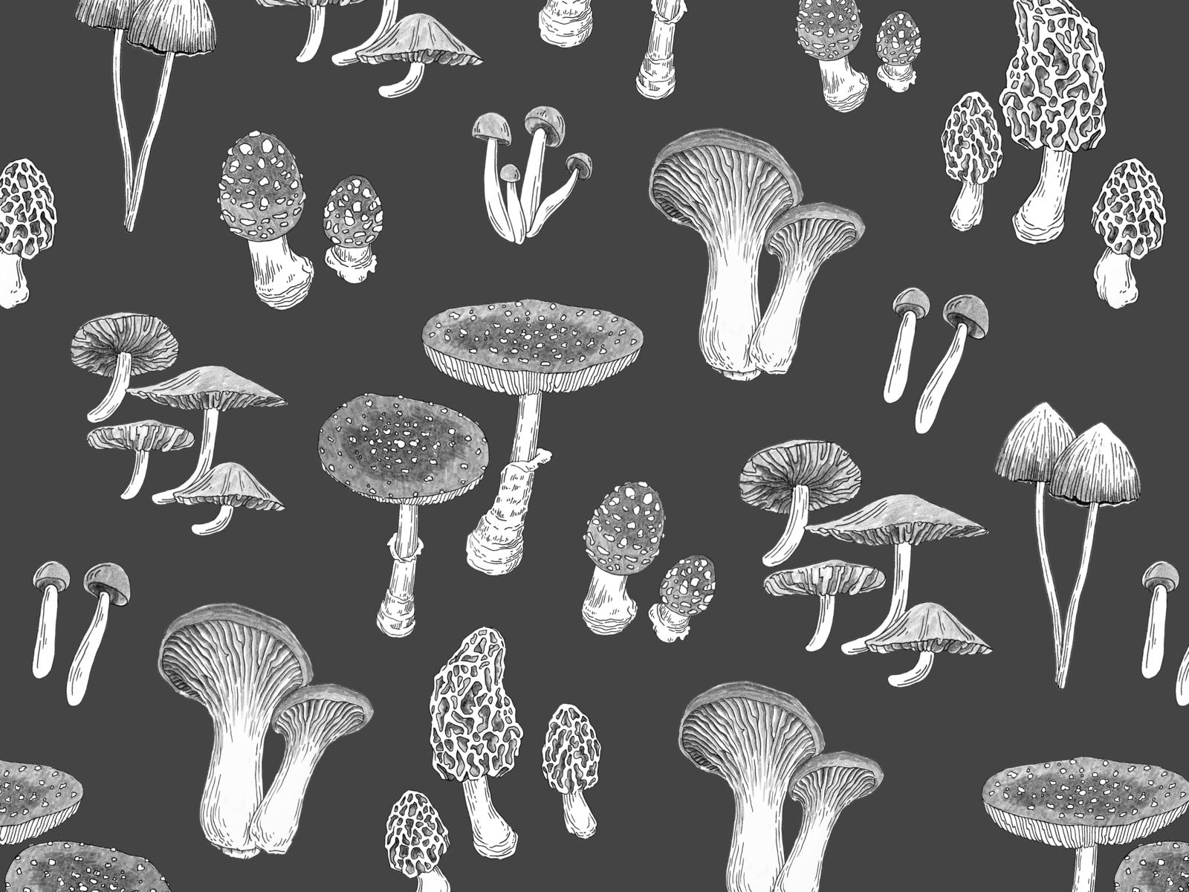
Project Goal
Develop a binary classification model for mushrooms
Predict if mushrooms are edible or poisonous based on physical attributes
Ensure public safety through accurate classification

Slide 6
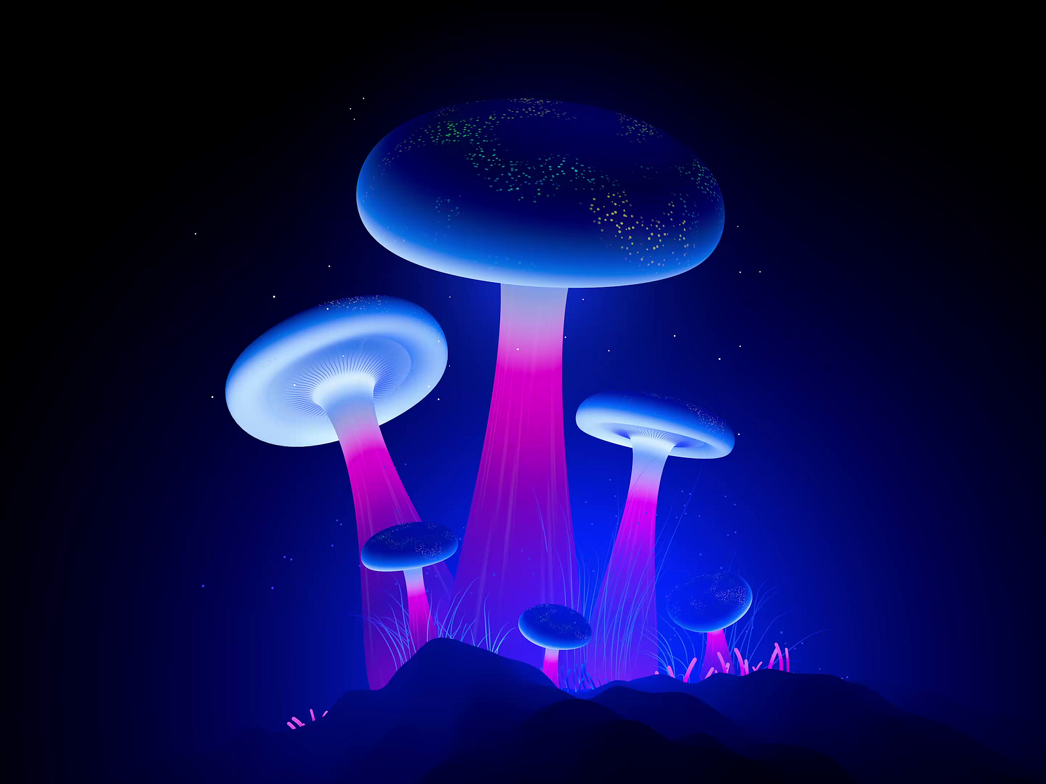
Mushroom Overview
Mushrooms are a section of a fungus
Toxins used to prevent consumption
No simple guidelines to identify mushrooms as poisonous
Difference between edible and poisonous mushrooms are extremely slight
Experienced mycologists make mistakes

Slide 7
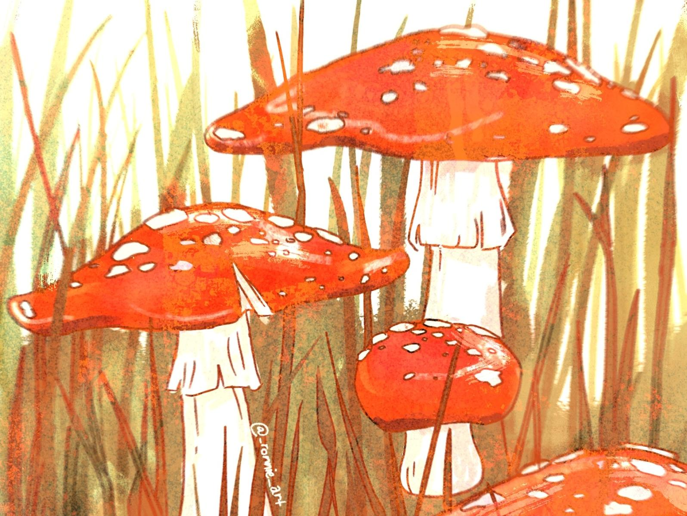
Common Myths
Folklore has created many false truths about mushrooms:
Myth: Poisonous mushrooms always have bright and flashy colors
Myth: Snails, insects, or other animals won’t eat poisonous mushrooms
Myth: Toxic mushrooms smell and taste horrible
Myth: Any mushroom becomes safe if cooked/processed enough

Slide 8
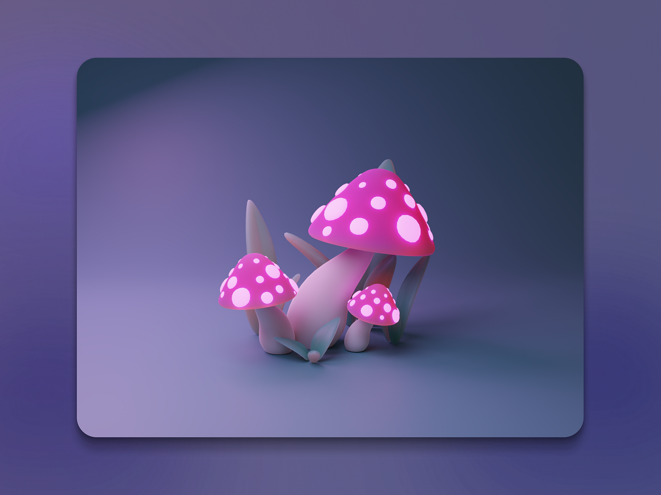
Impact
There are around 7,428 cases of exposure to toxic mushrooms, mostly by ingestion, each year.

Slide 9
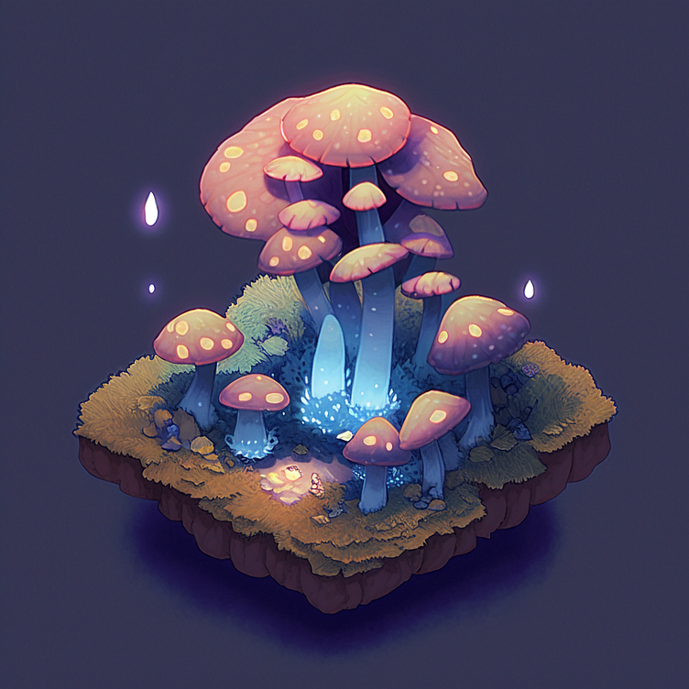
01
Project Overview

Slide 10
Dataset Overview
Categorical dataset with 8,124 instances and 21 attributes
Class attribute is the edibility of the mushroom
Sourced from The Audubon Society Field Guide to North American Mushrooms
Missing values: 2,480 instances in the stalk-root attribute
Class distribution: 52% edible, 48% poisonous (includes unknown classifications)

Slide 11
Attributes
class: edible = e, poisonous = p
cap-shape: bell = b, conical = c, convex = x, flat = f, knobbed = k, sunken = s
cap-surface: fibrous = f, grooves = g, scaly = y, smooth = s
cap-color: brown = n, buff = b, cinnamon = c, gray = g, green = r, pink = p, purple = u, red = e, white = w, yellow = y
bruises: true = t, false = f
odor: almond = a, anise = l, creosote = c, fishy = y, foul = f, musty = m, none = n, pungent = p, spicy = s
gill-attachment: attached = a, descending = d, free = f, notched = n
gill-spacing: close = c, crowded = w, distant = d
gill-size: broad = b, narrow = n
gill-color: black = k, brown = n, buff = b, chocolate = h, gray = g, green = r, orange = o, pink = p, purple = u, red = e, white = w, yellow = y
stalk-shape: enlarging = e, tapering = t
stalk-root: bulbous = b, club = c, cup = u, equal = e, rhizomorphs = z, rooted = r
stalk-surface-above-ring: fibrous = f, scaly = y, silky = k, smooth = s
stalk-surface-below-ring: fibrous = f, scaly = y, silky = k, smooth = s
stalk-color-above-ring: brown = n, buff = b, cinnamon = c, gray = g, orange = o, pink = p, red = e, white = w, yellow = y
stalk-color-below-ring: brown = n, buff = b, cinnamon = c, gray = g, orange = o, pink = p, red = e, white = w, yellow = y
veil-type: partial = p, universal = u
veil-color: brown = n, orange = o, white = w, yellow = y
ring-number: none = n, one = o, two = t
ring-type: cobwebby = c, evanescent = e, flaring = f, large = l, none = n, pendant = p, sheathing = s, zone = z
spore-print-color: black = k, brown = n, buff = b, chocolate = h, green = r, orange = o, purple = u, white = w, yellow = y
population: abundant = a, clustered = c, numerous = n, scattered = s, several = v, solitary = y
habitat: grasses = g, leaves = l, meadows = m, paths = p, urban = u, waste = w, woods = d

Slide 12
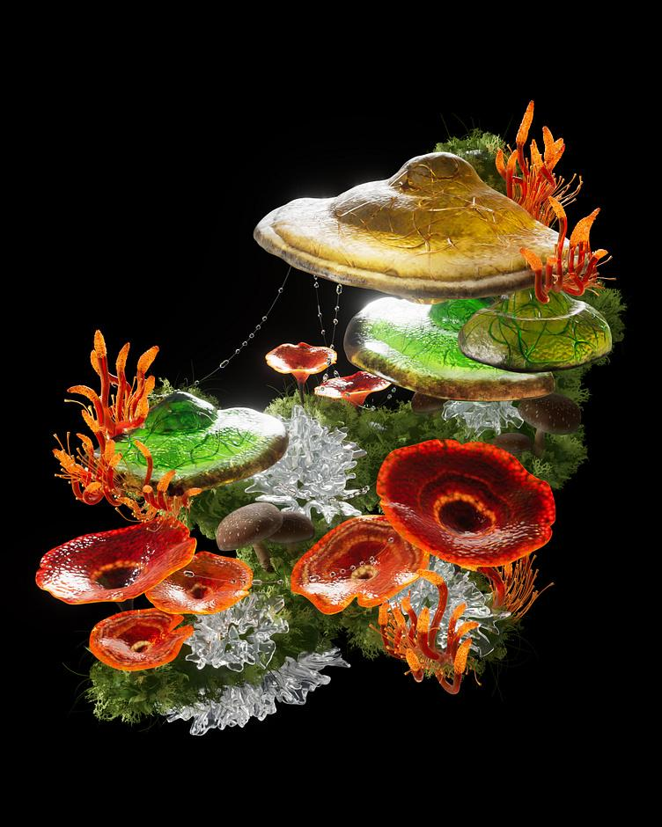
02
Preprocessing

Slide 13
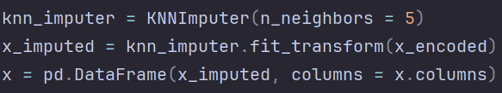
Missing Value Handling
Implemented the K-Nearest-Neighbors (KNN) algorithm
Estimates missing values by analyzing the closest neighbors based on features
Surpasses mode/deletion (reflects underlying patterns in the data)
KNN Imputer implementation using scikit-learn method and depth 5 consideration

Slide 14
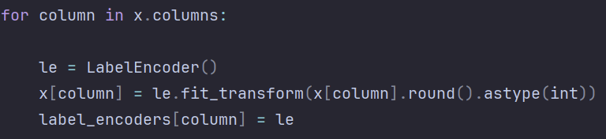
Feature Encoding
All of the data in the mushrooms dataset are categorical variables
Cap shape: bell (b) → 0, conical (c) → 1, flat (f) → 2 Odor: almond (a) → 0, fishy (y) → 8
Encodings using scikit-learn functionality

Slide 15
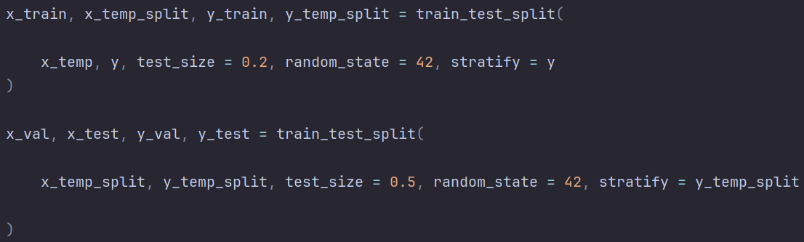
Dataset Splitting
Training Set: 80% of data for model training
Validation Set: 10% for hyperparameter tuning
Testing Set: 10% for unbiased evaluation of model performance
Split with stratified distribution using scikit-learn functionality

Slide 16
03
Manipulation

Slide 17
Attribute Selection Algorithms
Selection Algorithm | Strengths | Weaknesses
Intuition | Simple to perform, takes the least amount of time | Prone to bias, can’t be reproduced
Correlation Attribute Evaluation | Computationally efficient calculation in a straightforward way | Can only detect linear relationships, skewed by outliers
Gain Ratio Attribute Evaluation | Reduces overfitting, useful for Decision Trees | Ineffective with attributes that have only a few unique values
Information Gain Attribute Evaluation | Works with both categorical and discrete data | Biased toward attributes with many categories
Wrapper Subset Evaluation | Selection based on the specific model | Risks overfitting, especially when dataset is small

Slide 18
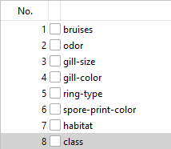
Intuition-Based Selection
Basic selection based on personal consideration of the influence of attributes
We watched National Geographic as kids (unofficial experts)

Slide 19
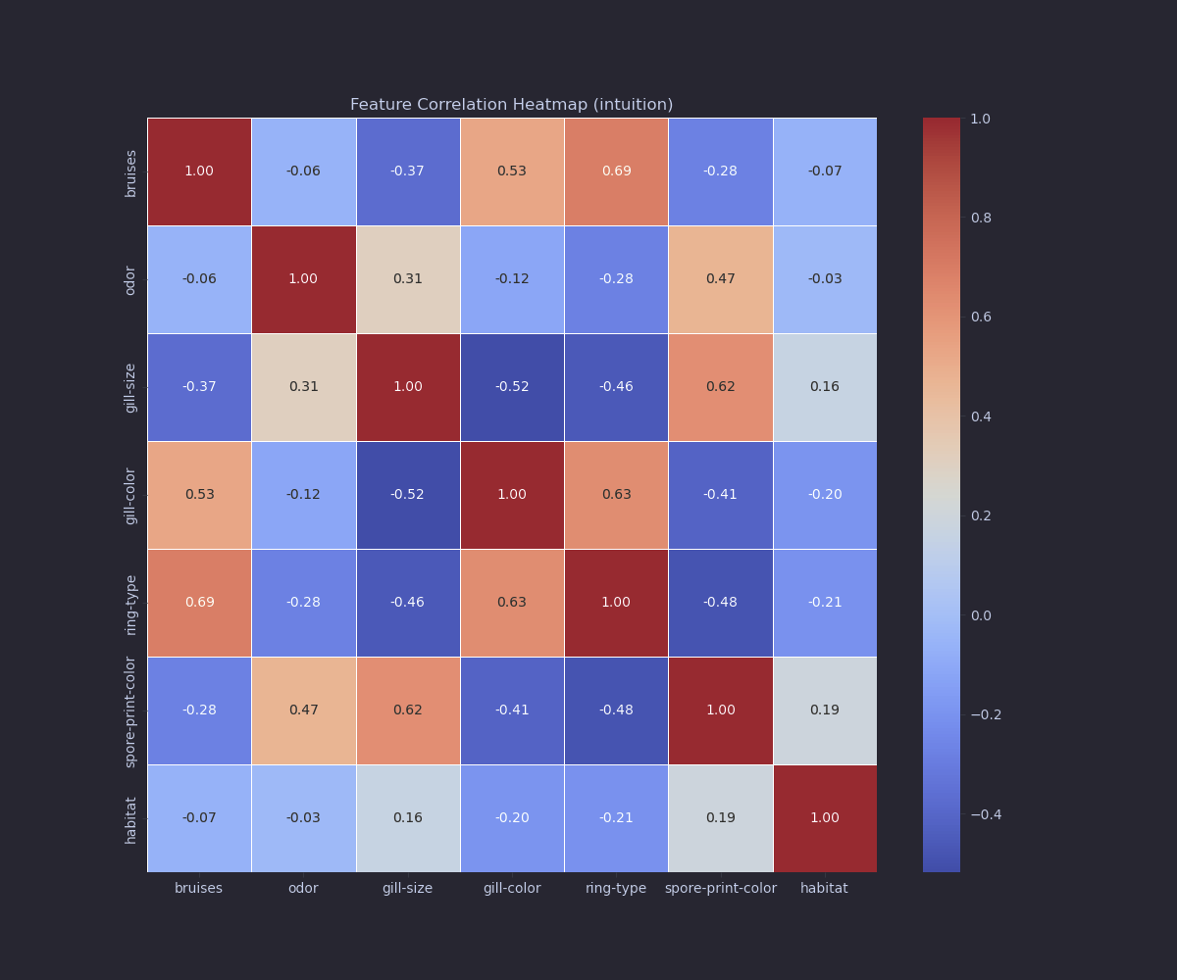

Slide 20
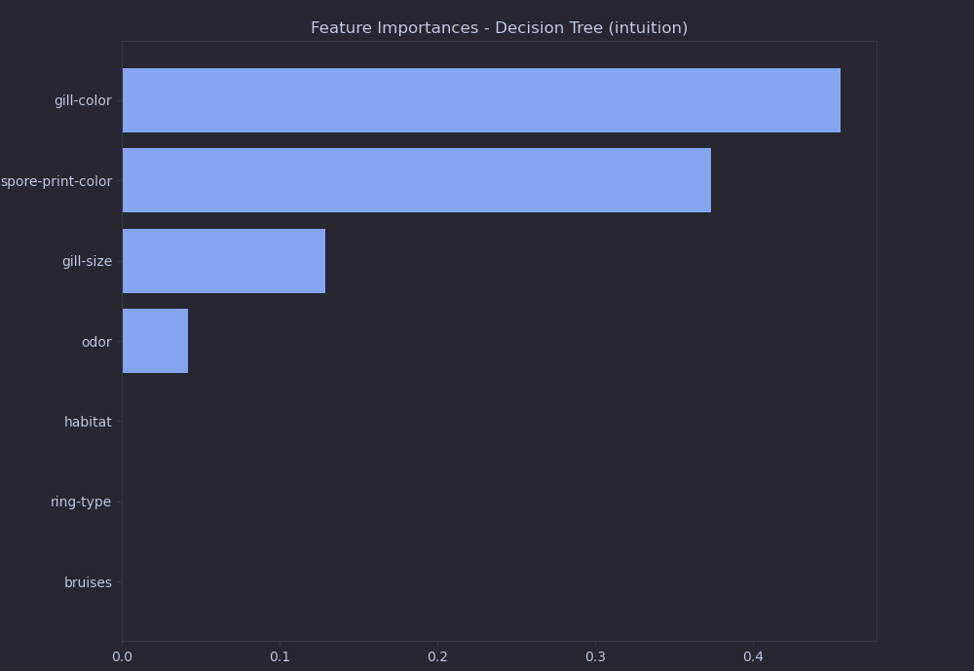

Slide 21
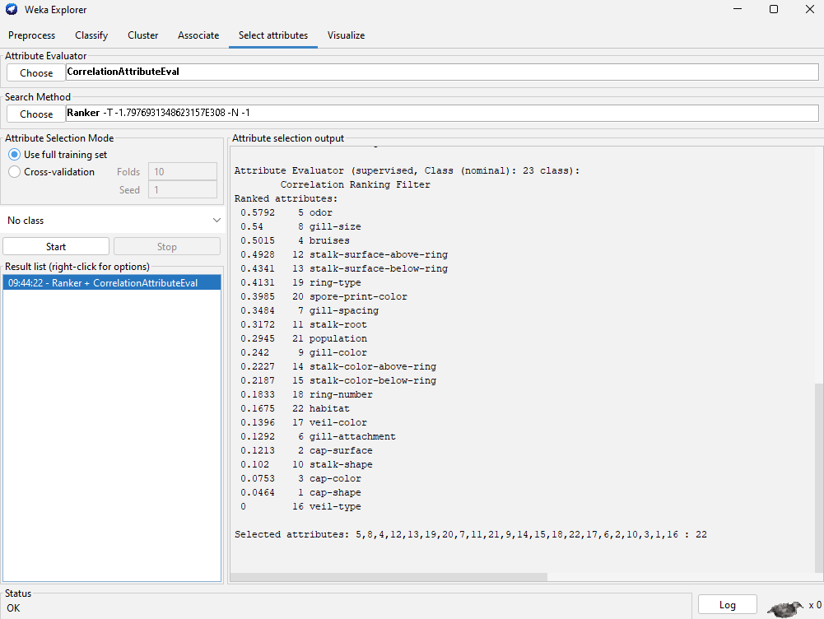
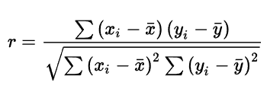
Correlation Attribute Evaluation
Measures the linear correlation between attributes and class labels
Cutoff value: 0.25

Slide 22
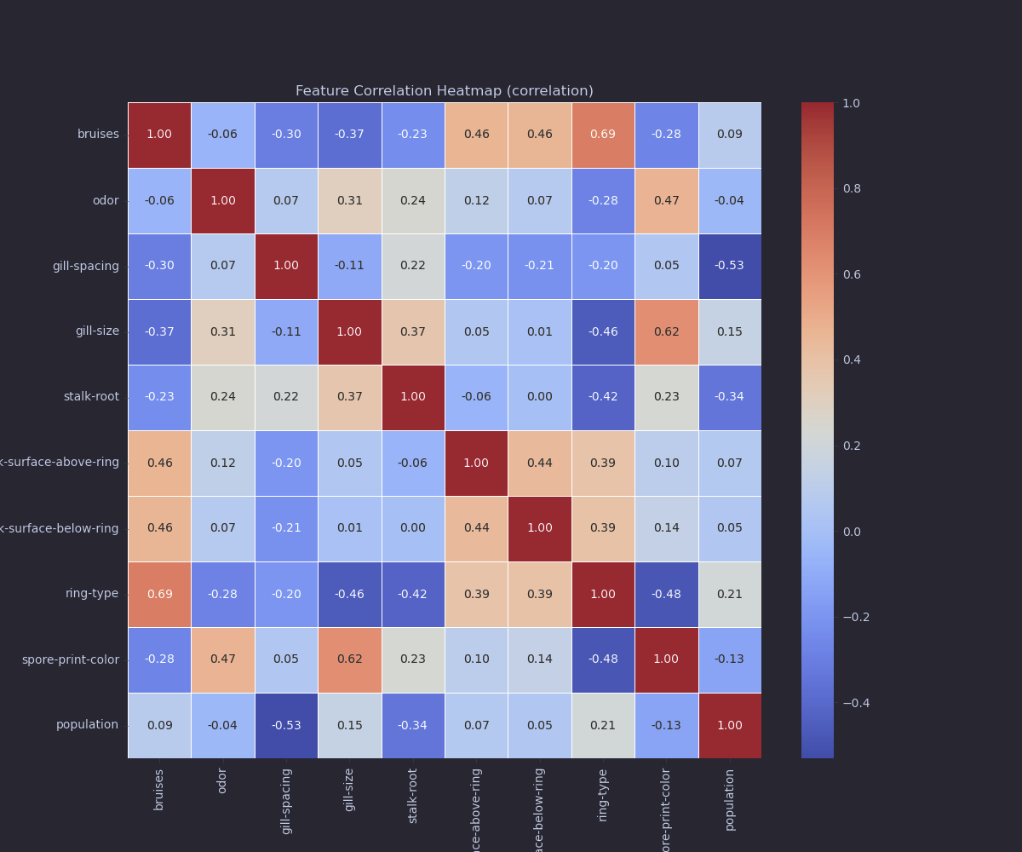

Slide 23
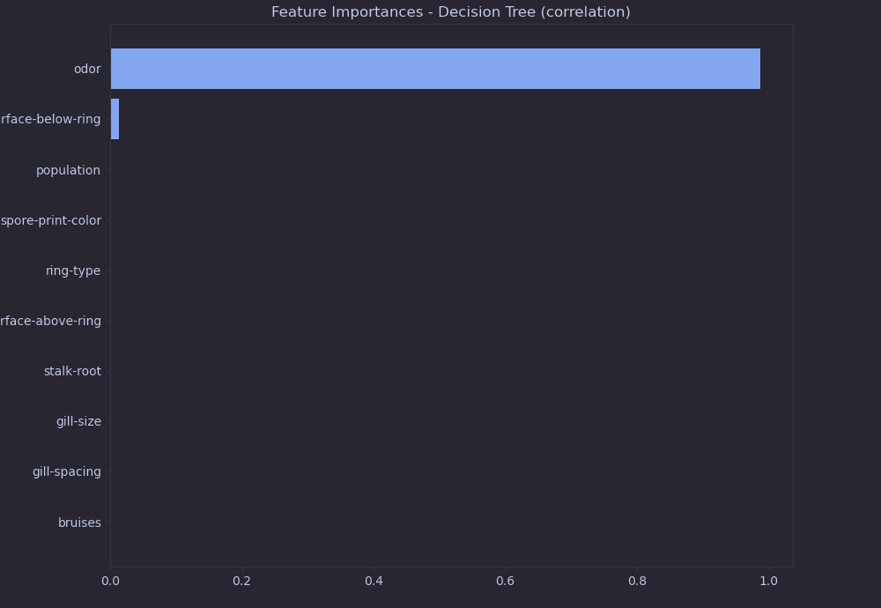

Slide 24

Gain Ratio Attribute Evaluation
Ranks attributes based on their gain ratio with respect to the class
Gain ratio reduces bias towards attributes that have many distinct values
Cutoff value: 0.15

Slide 25
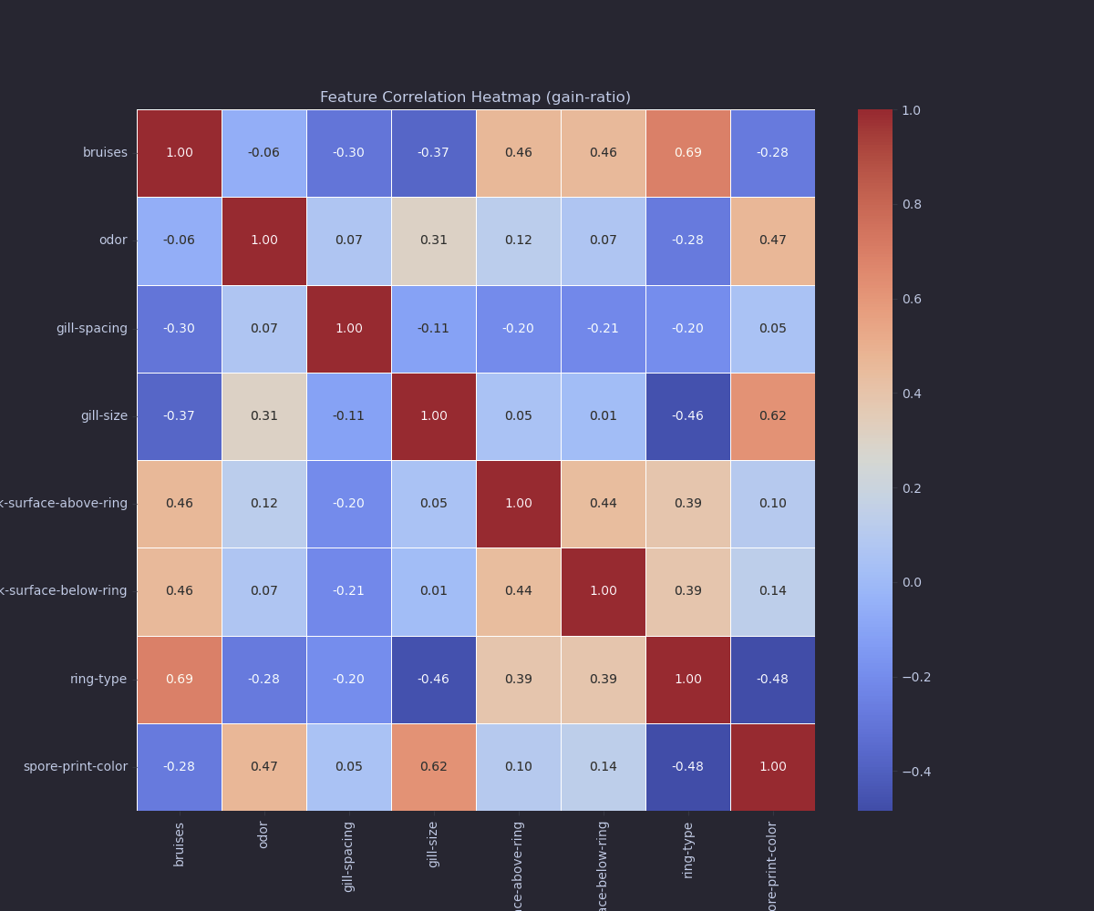

Slide 26
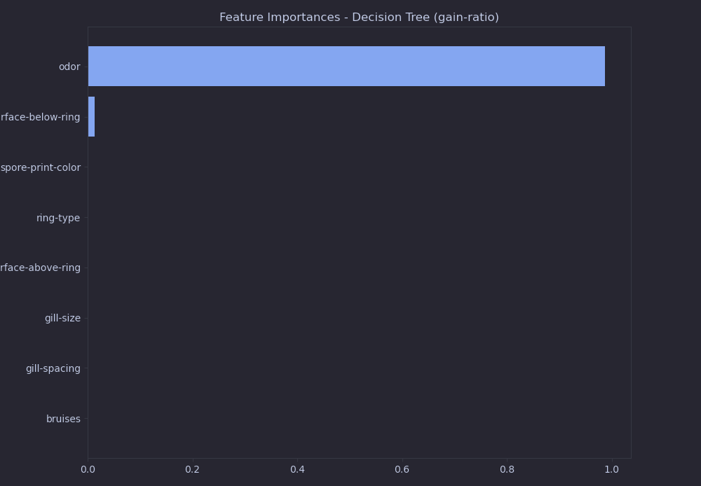

Slide 27
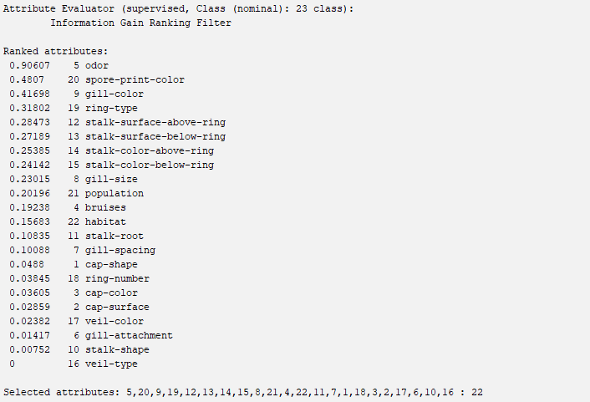
Information Gain Attribute Evaluation
Ranks attributes based on their information gain with respect to the class
Information gain = reduction in entropy about the class
Cutoff value: 0.2

Slide 28
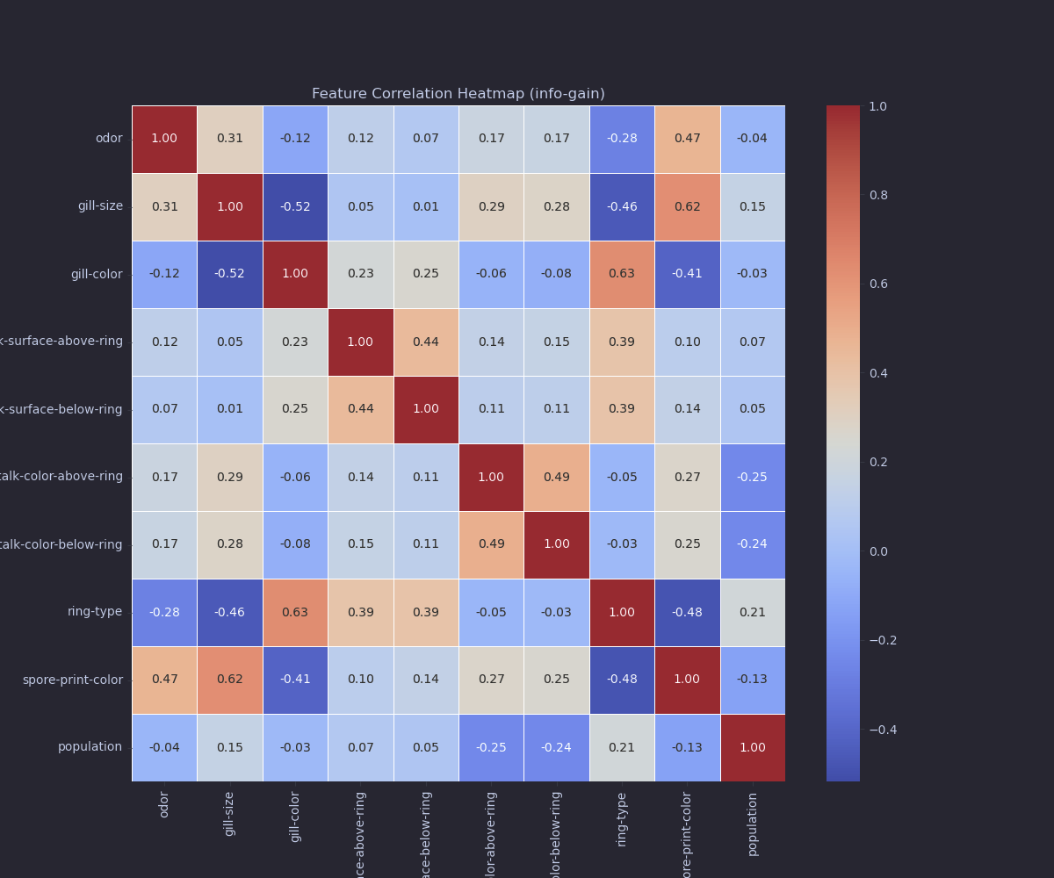

Slide 29
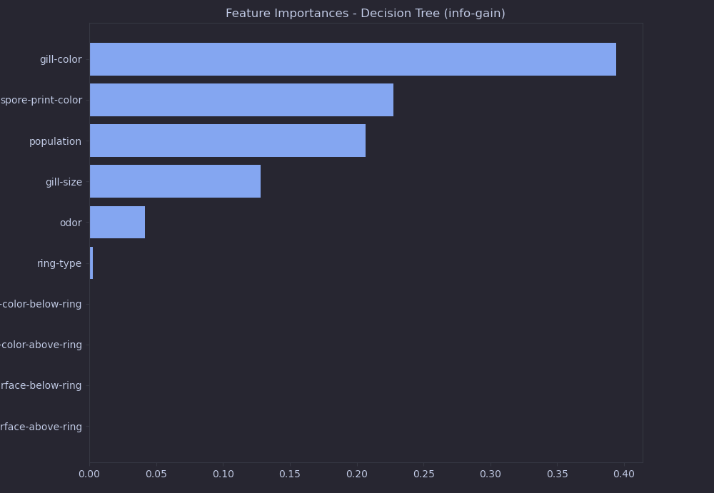

Slide 30
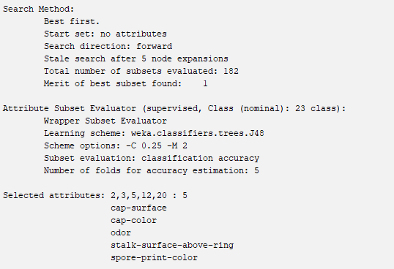
Wrapper Subset Evaluation
Evaluates the performance of a subset of attributes using J48 Decision Tree classifier
Direct measure of the impact of selected attributes on model performance

Slide 31
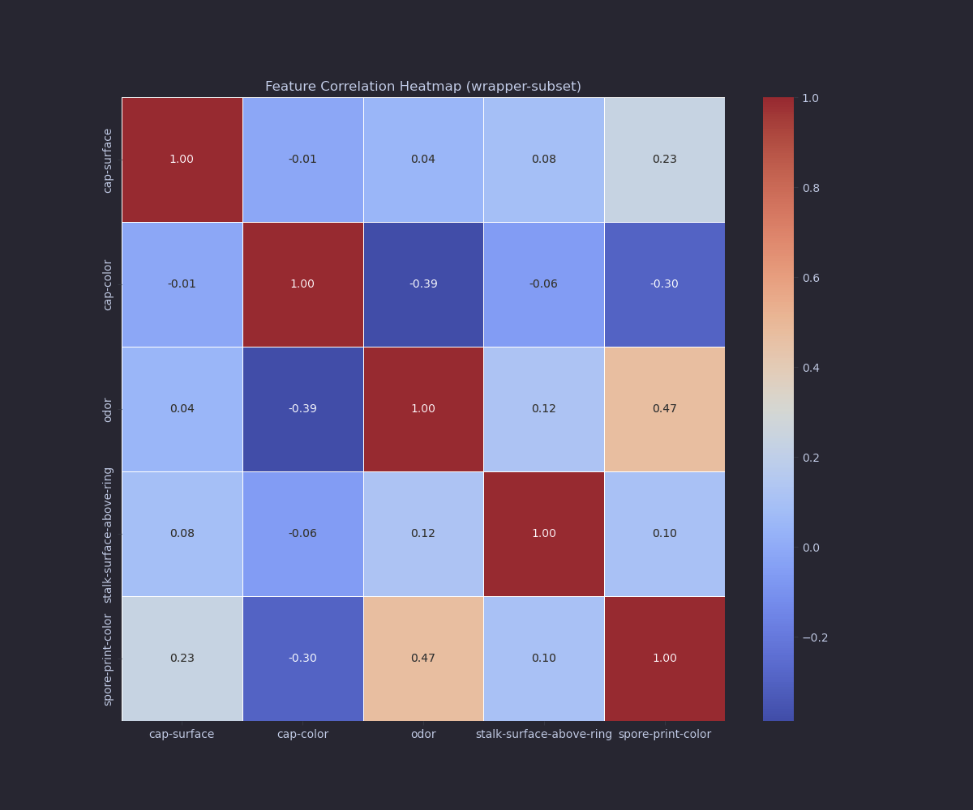

Slide 32
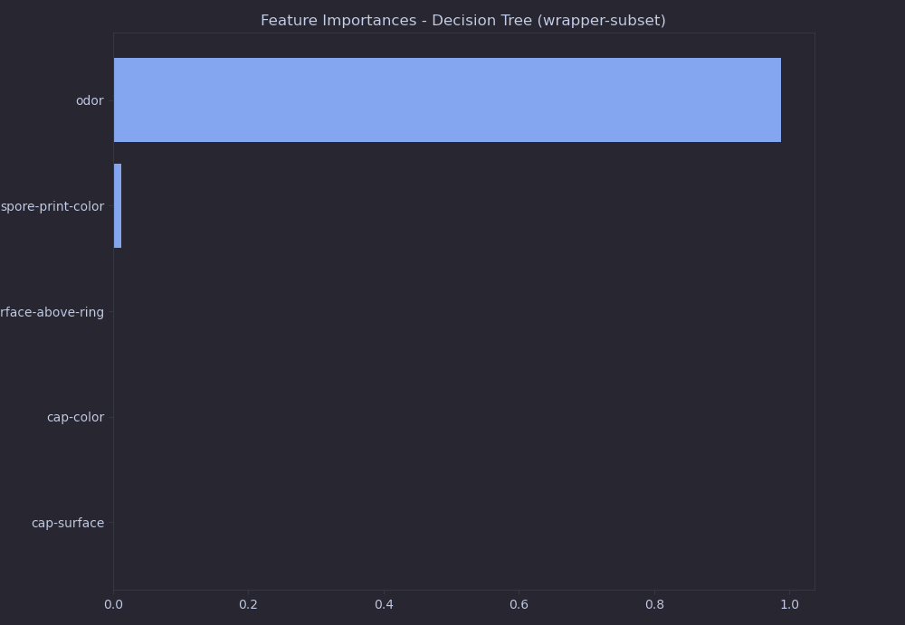

Slide 33
Classifier Models
Decision Tree (J48): Uses rules to classify data by approximating a sine curve
Quadratic Discriminant Analysis (QDA): Generates a quadratic boundary by fitting Gaussian densities to classes
Logistic Regression: Utilizes a Bernoulli distribution to predicts probabilities for binary outcomes
Support Vector Classifier (SVC): Finds optimal “hyperplane” for data (the decision boundary that maximizes the distance between the closest data points of two attributes)
Models were trained using scikit-learn and stored with pickle library serialization

Slide 34
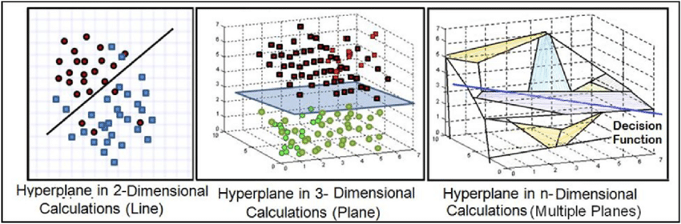
Hyperplane

Slide 35
Comparison of Models
Model | Strengths | Weaknesses
J48 Decision Tree | Easy to use | Prone to overfitting
Logistic Regression | Good for binary classification | Struggles with non-linear relationships
SVC | Handles complex data well | Very slow
QDA | Works well with nonlinear relationships | Sensitive to dataset size

Slide 36
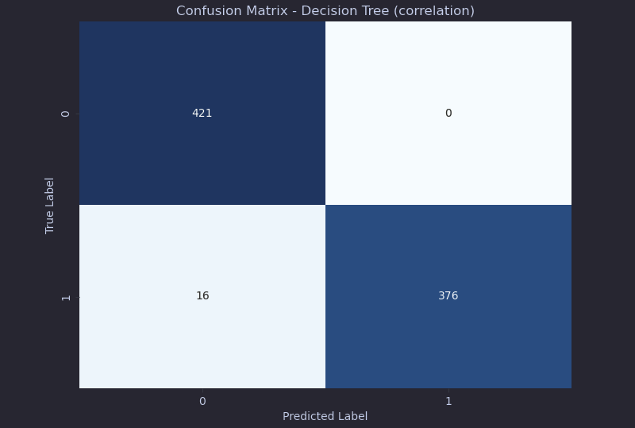

Slide 37
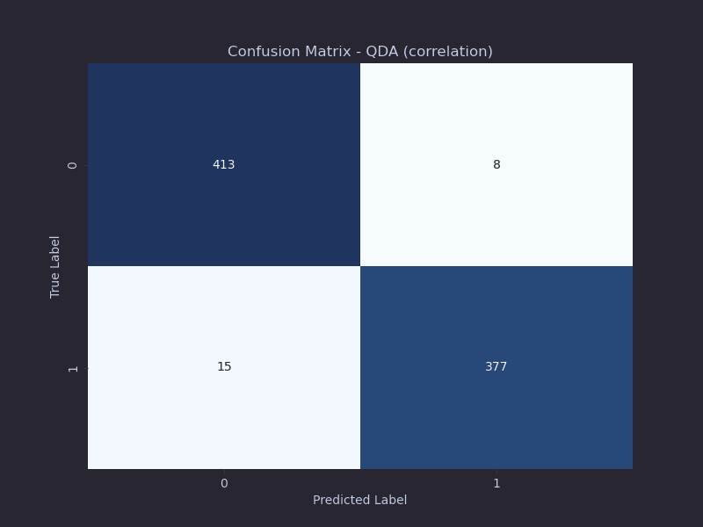

Slide 38
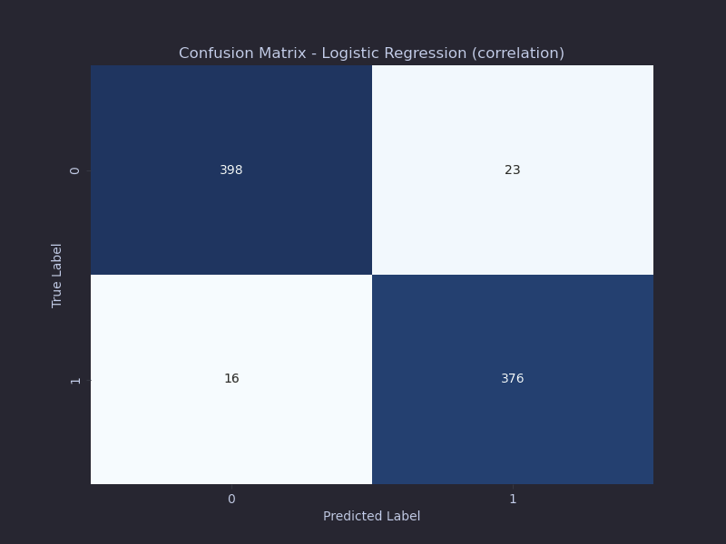

Slide 39


Slide 40
04
Conclusion

Slide 41
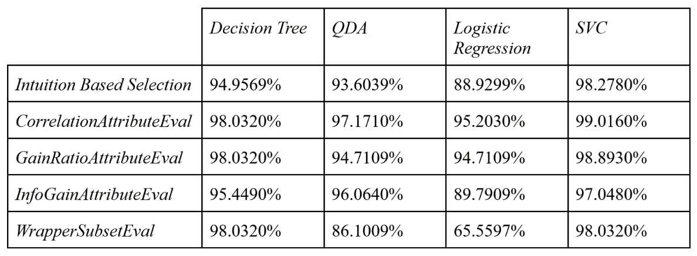
Accuracy Results
Support Vector Classifier (SVC) with CorrelationAttributeEval performed the best

Slide 42
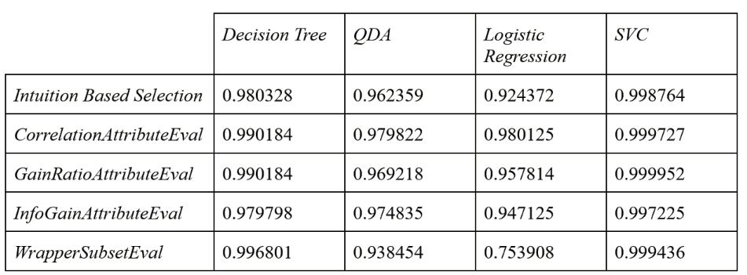
ROC Area Results
Support Vector Classifier (SVC) with GainRatioAttributeEval performed the best

Slide 43
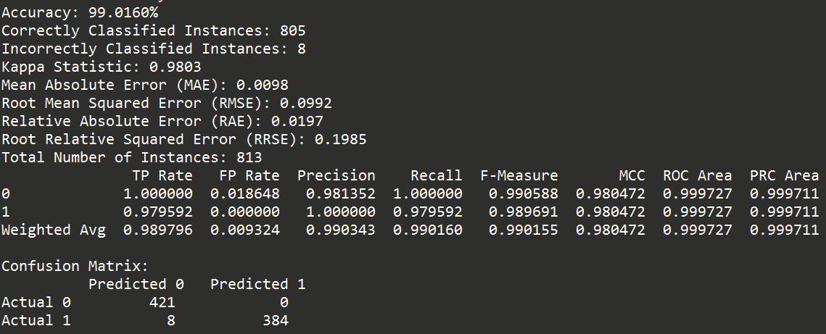
Metrics for Chosen Model (SVC + Correlation)

Slide 44
Future Work
Using Correlation as a selection algorithm could overlook attributes that might have high correlation when combined with other attributes
Exploring alternative attribute selection algorithms
Experimenting with different classifier models (e.g. Random Forest, Gradient Boosting)

Slide 45
Sources
Blythe, V. (n.d.). Mushrooms [Image]. Dribbble. https://dribbble.com/shots/14323122-Mushrooms
Brandenburg, W. E., & Ward, K. J. (2018, July 31). Mushroom poisoning epidemiology in the United States. National Library of Medicine. Retrieved October 23, 2024, from https://doi.org/10.1080/00275514.2018.1479561
Colors, C. (n.d.). Glowing Mushrooms [Image]. Dribbble. https://dribbble.com/shots/22519055-Glowing-Mushrooms
DecisionTreeClassifier. (n.d.). scikit-learn. Retrieved October 22, 2024, from https://scikit-learn.org/stable/modules/generated/sklearn.tree.DecisionTreeClassifier.html
1.4. Support Vector Machines. (n.d.). scikit-learn. Retrieved October 22, 2024, from https://scikit-learn.org/1.5/modules/svm.html
Lillo, W. (n.d.). Isometric Mushrooms [Image]. Dribbble. https://dribbble.com/shots/20837558-Isometric-Mushrooms
LogisticRegression. (n.d.). scikit-learn. Retrieved October 22, 2024, from https://scikit-learn.org/1.5/modules/generated/sklearn.linear_model.LogisticRegression.html

Slide 46
Sources
Miminoshvili, A. (n.d.). Mushrooms [Image]. Dribbble. https://dribbble.com/shots/3641736-Mushrooms
MKL47. (n.d.). Mushrooms set [Image]. Dribbble. https://dribbble.com/shots/23206484-Mushrooms-set
Package weka.attributeSelection. (n.d.). Weka Documentation. Retrieved October 22, 2024, from https://weka.sourceforge.io/doc.dev/weka/attributeSelection/package-summary.html
QuadraticDiscriminantAnalysis. (n.d.). scikit-learn. Retrieved October 22, 2024, from https://scikit-learn.org/stable/modules/generated/sklearn.discriminant_analysis.QuadraticDiscriminantAnalysis.html
Schultz, P. (n.d.). Mushroom Pattern [Image]. Dribbble. https://dribbble.com/shots/5709006-Mushroom-Pattern
Wild Mushrooms. (n.d.). The Blue Ridge Poison Center. Retrieved October 23, 2024, from https://med.virginia.edu/brpc/wp-content/uploads/sites/274/2015/10/Mushrooms.pdf

Slide 47
Thank you!

